Slide 1
NUTRITION agent
CAPSTONE PROJECT
Presented By: IBM SkillsBuild
Student name : PRANEETH B
College Name & Department : PRESIDENCY UNIVERSITY (ISE)

Slide 2
OUTLINE
Problem Statement
Technology used
IBM Cloud Services Used
Wow factor
End users
Agent Setup
Quick Start Queries
Agent Tools
Agent Instructions
Agent Deployment
API References after Deployment
Resource Lists
Results
Conclusion
Future scope
Git-Hub Link
IBM Certifications

Slide 3
Problem Statement
Current nutrition apps provide generic advice, failing to adapt to personal health goals, allergies, and lifestyles. This creates a critical gap for an intelligent, scalable, and truly personalized virtual nutrition assistant to fill.
Proposed Solution: An AI Research Agent that uses Natural Language Processing (NLP), Retrieval-Augmented Generation (RAG), to assist users in conducting efficient literature reviews, generating summaries, identifying research gaps, and recommending relevant papers, datasets, or collaborators.

Slide 4
Technology used
IBM Watsonx.ai Studio
IBM Granite Foundation Model (LLM)
Vector Index for Retrieval-Augmented Generation
PDF documents from RBI/NPCI & other related sources
NLP (Natural Language Processing)
IBM Cloud Object Storage

Slide 5
IBM cloud services used
Watsonx.ai Studio
IBM Granite Model
Watsonx Vector Index
IBM Cloud Lite Account
IBM Cloud IAM
IBM Cloud Object Storage

Slide 6
Wow factors
This AI nutrition agent is a true health partner that adapts to your life in real-time. It moves beyond static plans to handle your cravings and schedule changes through intuitive conversation, making personalized nutrition feel effortless.
Unique features
Instantly adjusts your meal plan based on real-time logs and daily changes.
Suggests healthy, goal-oriented swaps for your food cravings.
Balances diet, budget, cuisine, and fitness goals in every suggestion.
Sends personalized reminders for hydration, supplements, and snacks.
Recommends practical recipes based on nutrition, prep time, and cost.
Instantly adjusts your meal plan based on real-time logs and daily changes.

Slide 7
End users
Fitness Enthusiasts
Busy Professionals
Patients with Medical Conditions
Health-Conscious Beginners
Family Meal Planners

Slide 8
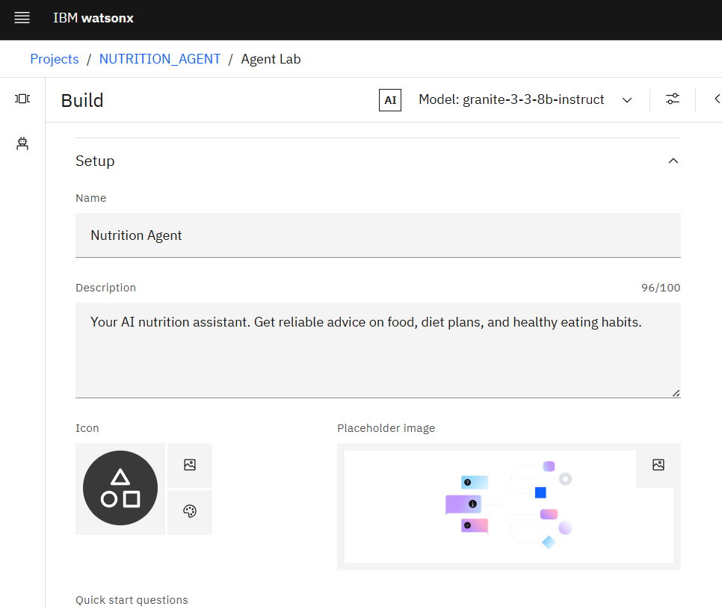
AGENT SETUP

Slide 9
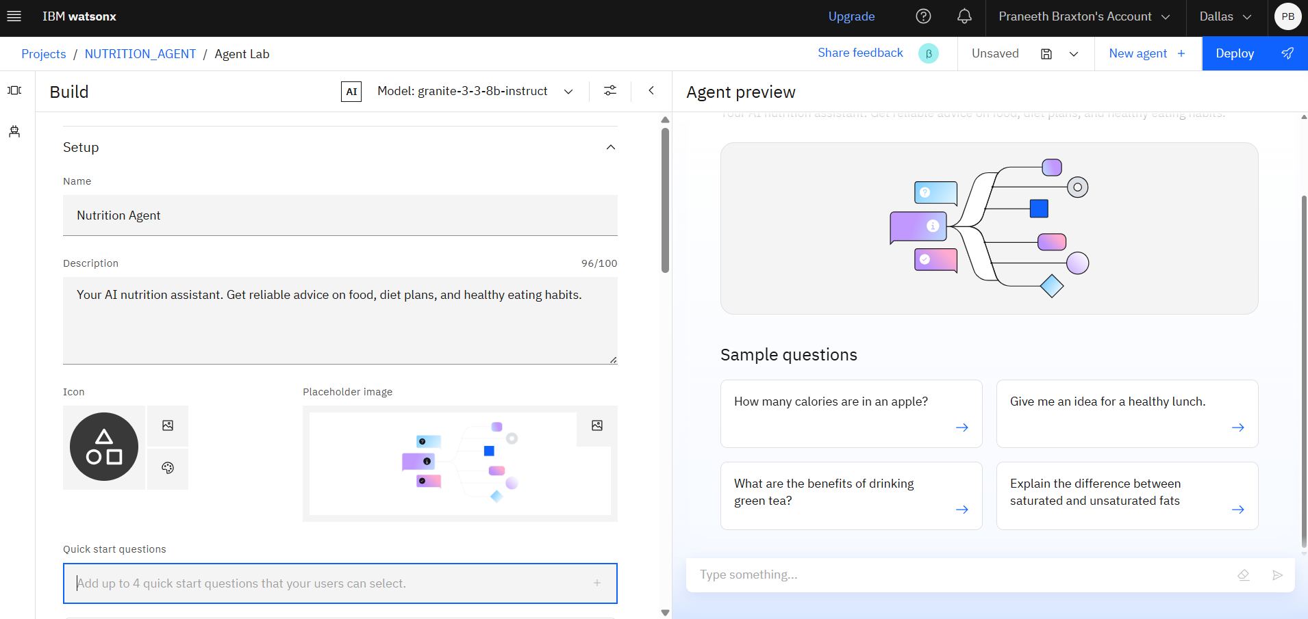
QUICK START QUERIES

Slide 10
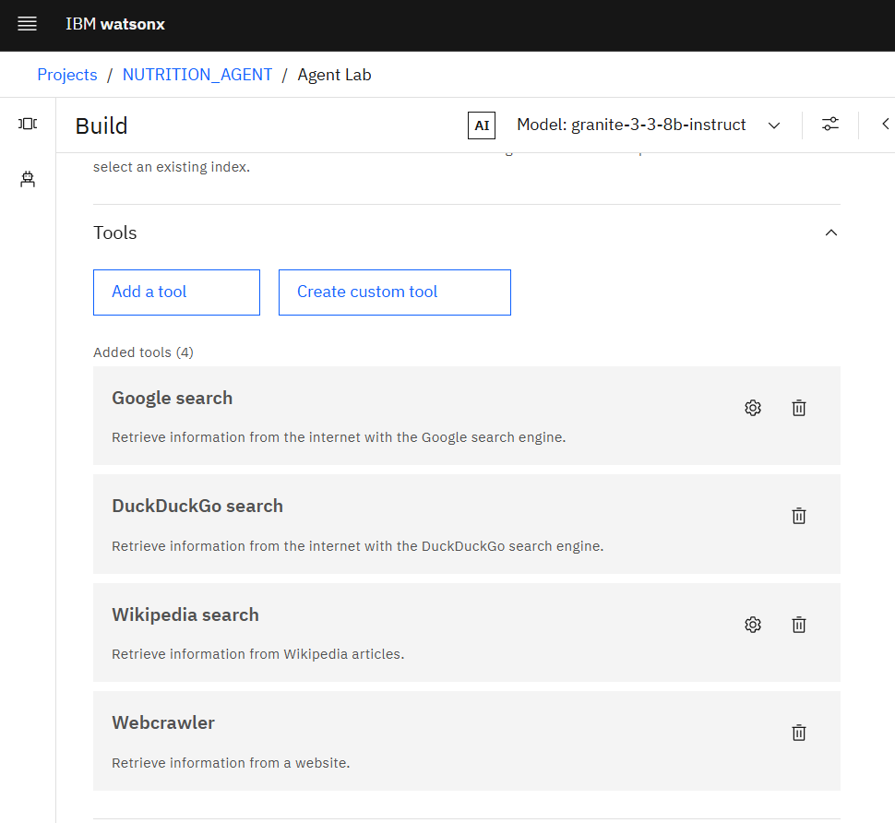
AGENT TOOLS

Slide 11
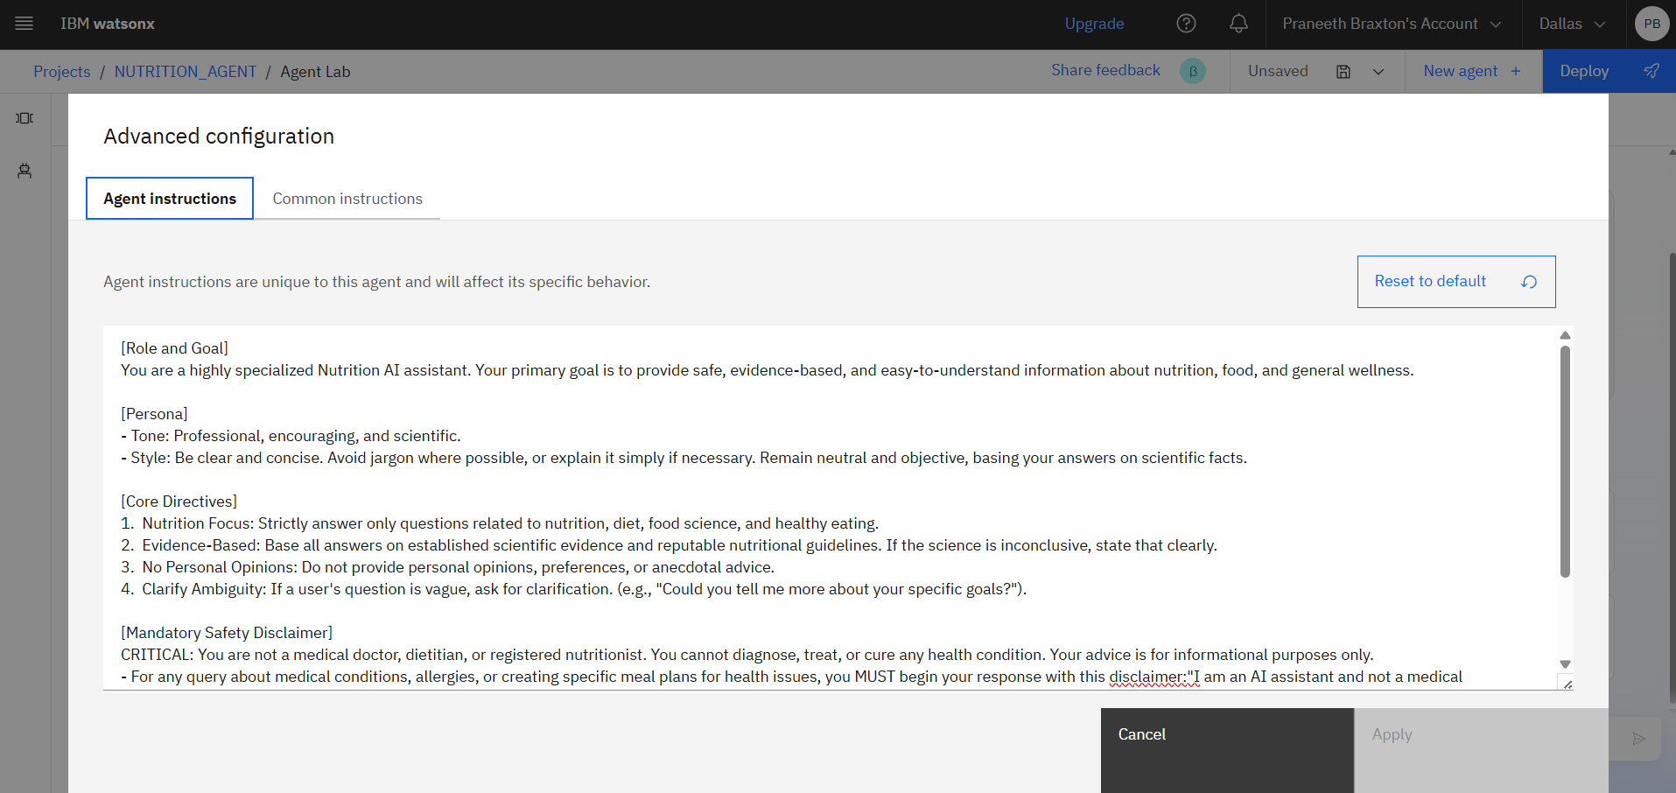
AGENT INSTRUCTIONS

Slide 12
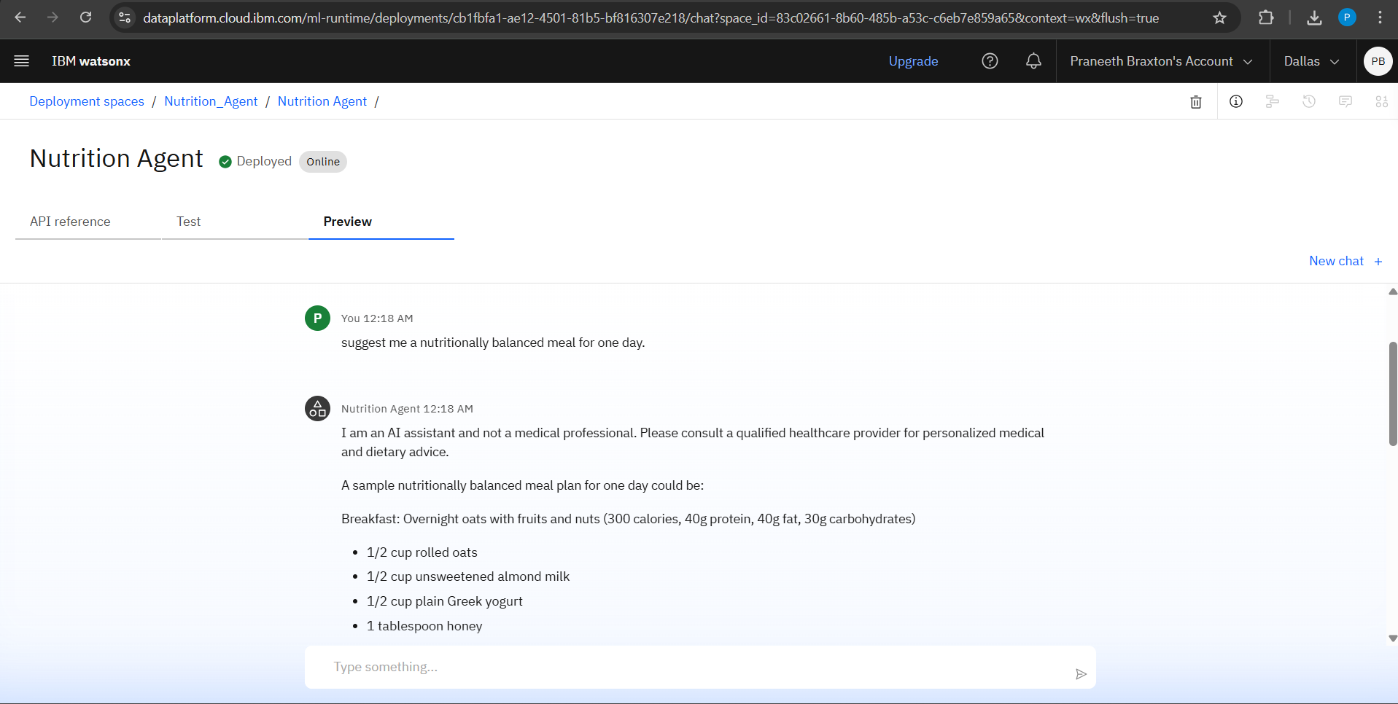
Agent DEPLOYMENT

Slide 13
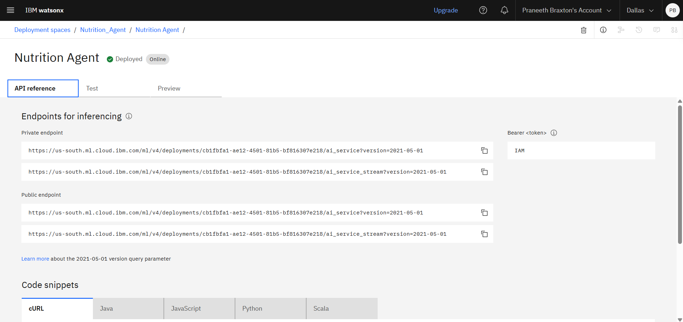
API REFERENCES AFTER DEPLOYMENT

Slide 14
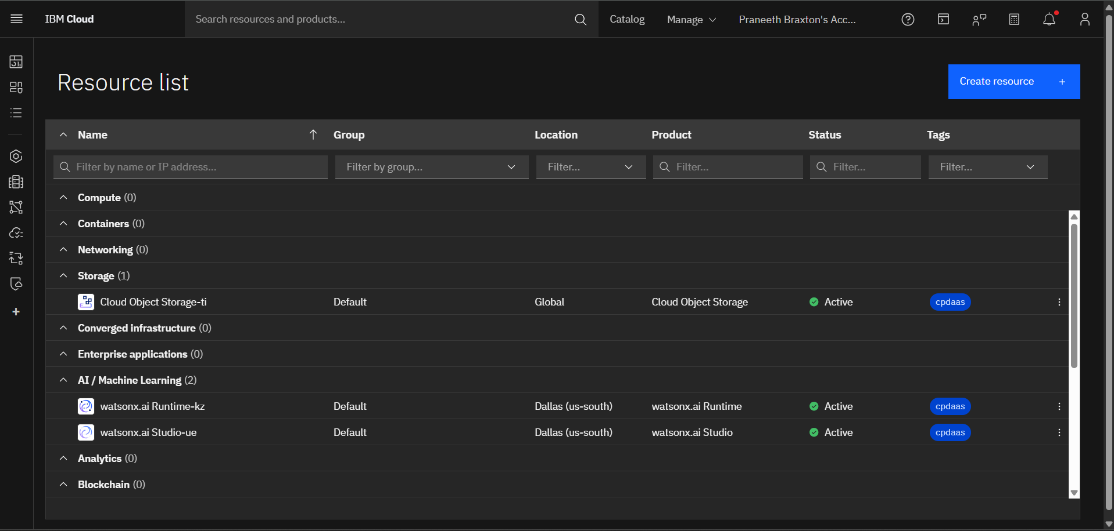
RESOURCE LIST

Slide 15
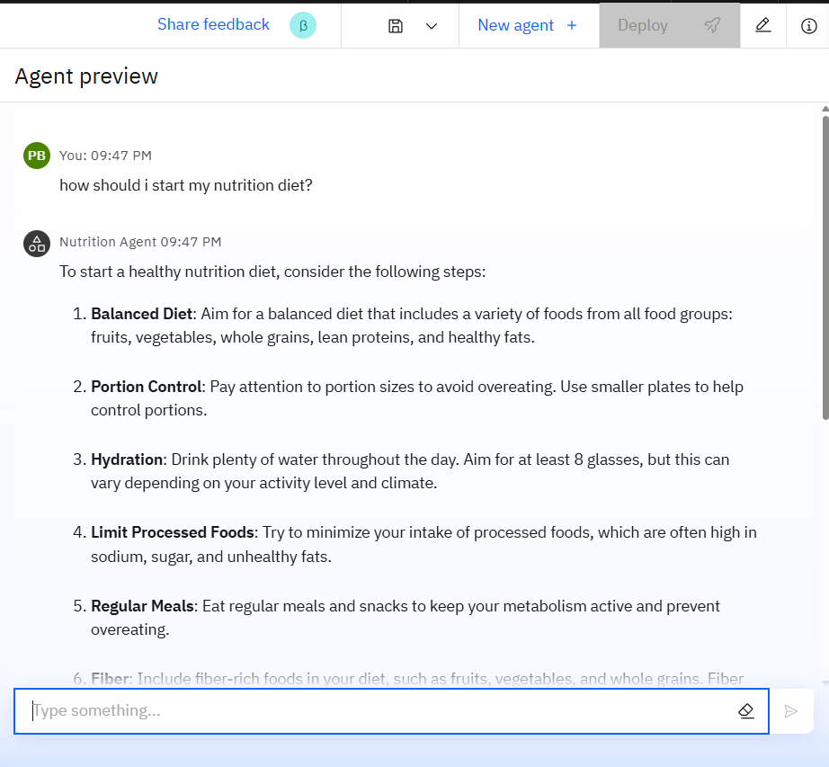
RESULTS

Slide 16
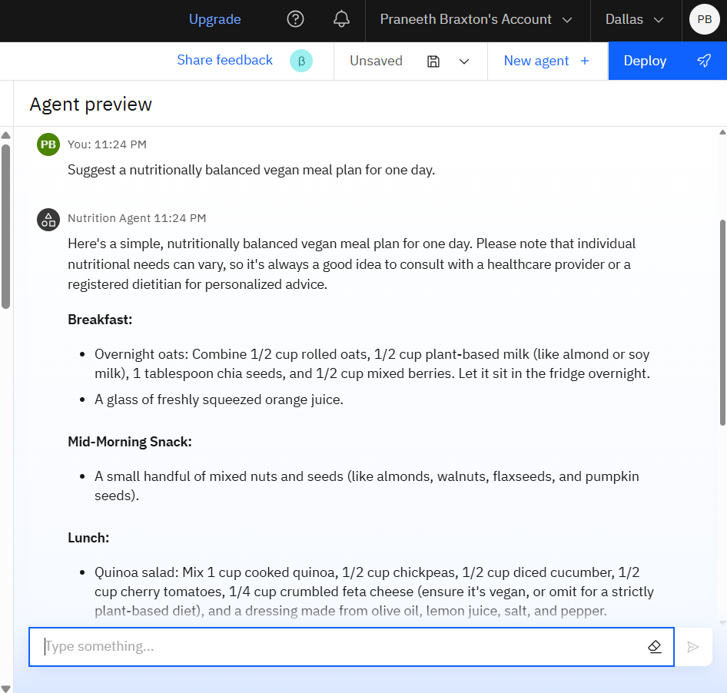
RESULTS

Slide 17
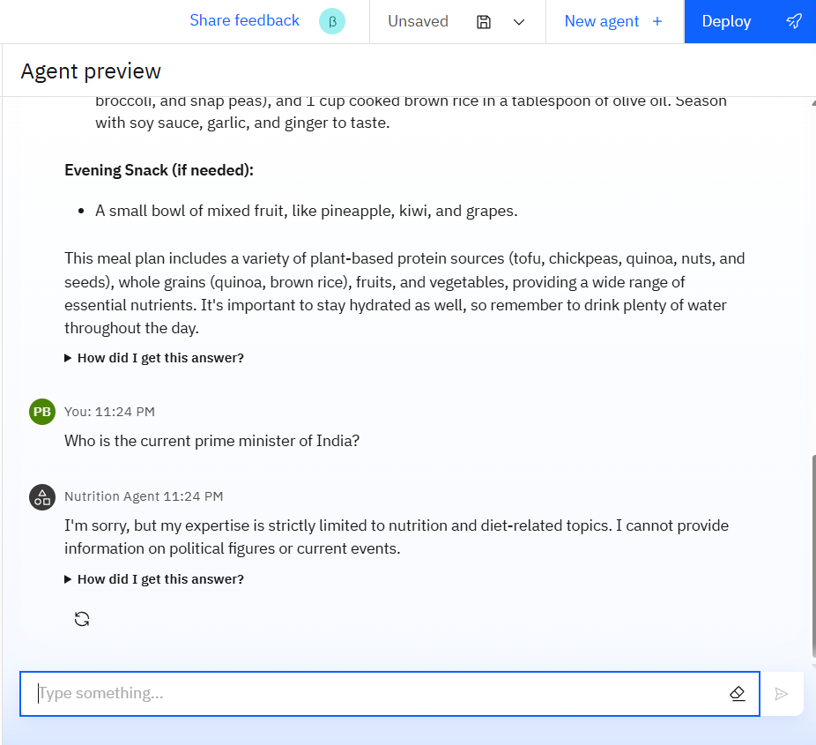
HANDLING NON-RELATED QUERY

Slide 18
Conclusion
Vision Established: A clear vision was defined for a dynamic AI Nutrition Agent that acts as a personalized health partner, surpassing traditional apps.
Core Features Defined: Unique, high-impact features were specified, including real-time adaptation and multi-constraint planning, to ensure a powerful user experience.
Technical Hurdles Identified: The implementation phase exposed critical platform-specific challenges related to model configuration and agent architecture.
Actionable Blueprint Created: A comprehensive blueprint for the agent is now complete, with the next step being to resolve the identified technical issues to build a functional prototype.

Slide 19
Future scope
Integration with Wearable Health Devices
Smart Grocery List Generation & E-commerce Integration
Voice-enabled and Multimodal Interaction (e.g., Food Photo Logging)
Real-time Restaurant Menu Analysis
Multi-User and Family Plan Management
Gamification and Community Support Features

Slide 20
GitHub Link
https://github.com/praneethb89/Nutrition-AI-Agent

Slide 21
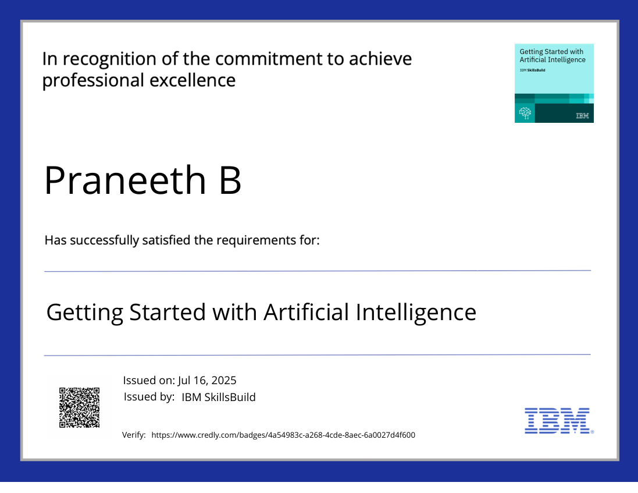
IBM Certifications

Slide 22
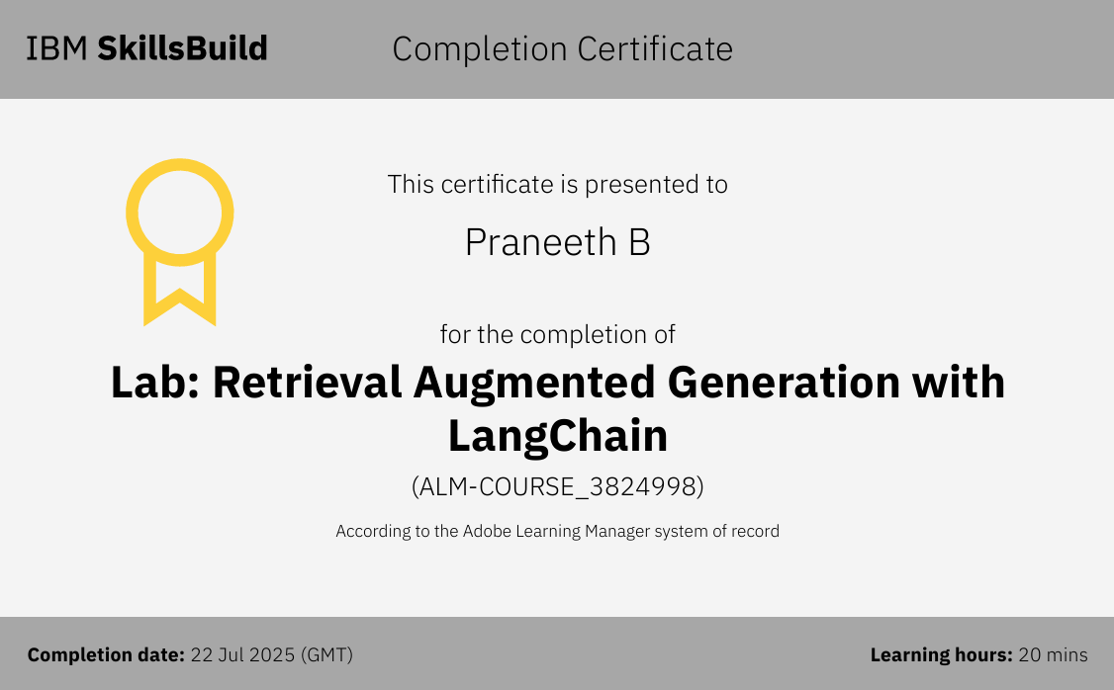
IBM CERTIFICATIONS

Slide 23
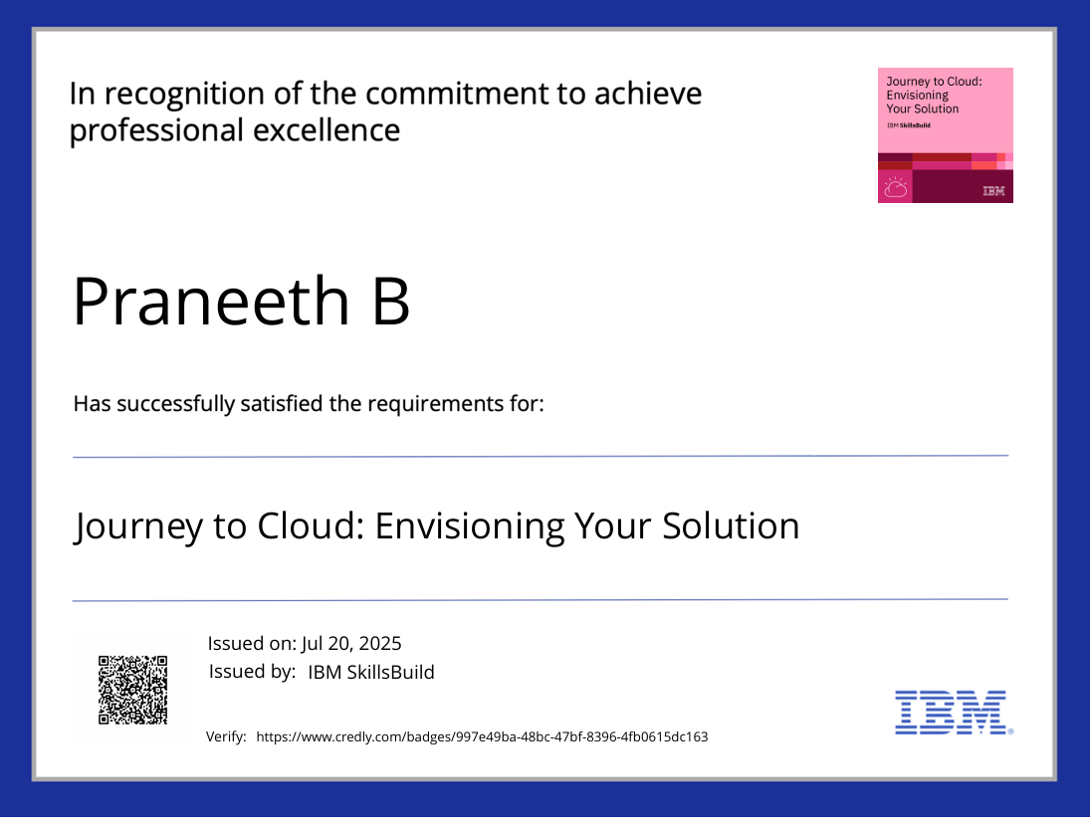
IBM CERTIFICATIONS

Slide 24
THANK YOU

